Slide 1

Rising incidence of diabetes in united states

Slide 2




team
Rayon King
Dominic Familette
Makenzie Eason
Jessica Guinn

Slide 3


Agenda
Age
Gender
Race
Death Rate
State Statistics
Correlations

Slide 4


Introduction
Our research delves into the intricate landscape of diabetes and its associated mortality rates, drawing insights from data compiled by the Centers for Disease Control and Prevention. With a focus on demographics statistics, we aim to establish correlations and uncover potential patterns to understand the impact of this growing health concern. Through an analysis of the provided data, we aim to contribute valuable insights into the complexity of diabetes-related deaths, and associated risk factors that may impact your chances of diabetes diagnosis.

Slide 5
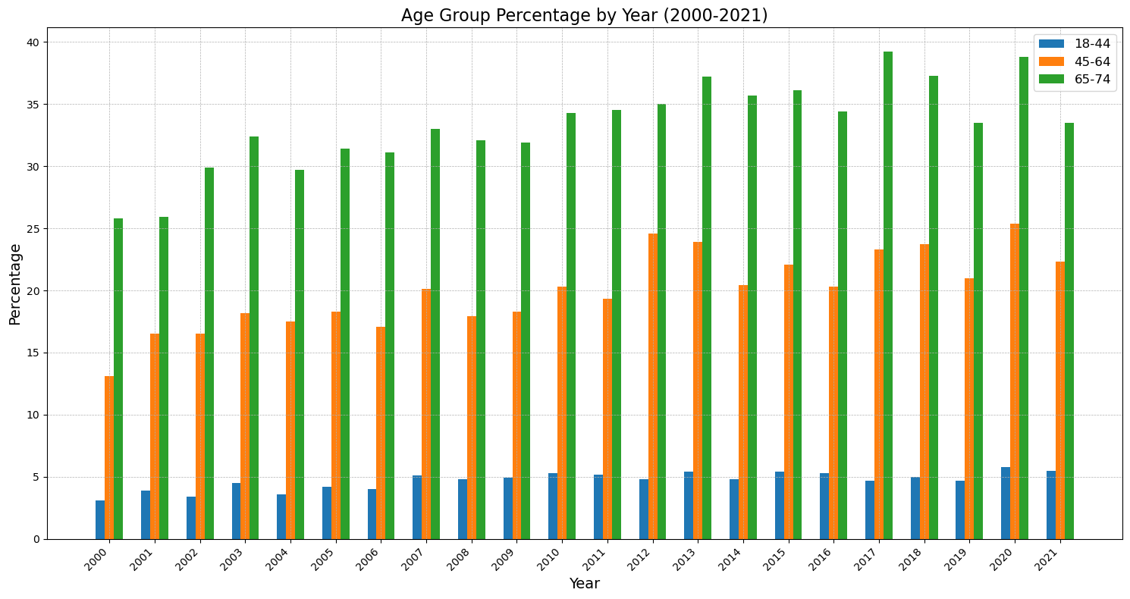
Age group by year analysis
The dataset collected contained age group percentages. This information shows us how the distribution population diagnosed with diabetes over time that has changed.
18-44 age group had an increase over the years, approximately 1.80% in 2000 to 3.22% in 2021. This suggests younger population health has been impacted in a negative manner.
45-64 age group has remained stable with moderate fluctuations over time.
65-74 age group has had a gradual upward trend

Slide 6
Gender
The dataset collected contained age group percentages. This information shows us how the distribution population diagnosed with diabetes over time that has changed.
18-44 age group had an increase over the years, approximately 1.80% in 2000 to 3.22% in 2021. This suggests younger population health has been impacted in a negative manner.
45-64 age group has remained stable with moderate fluctuations over time.

Slide 7
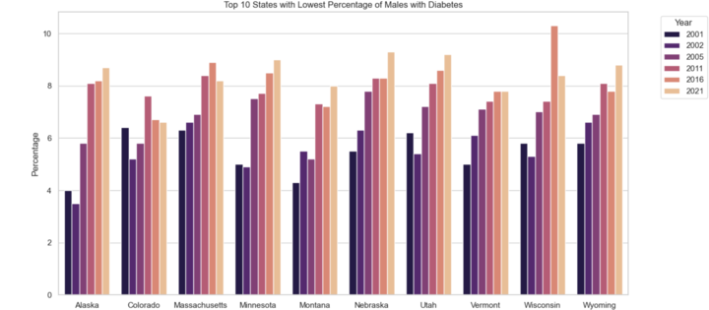
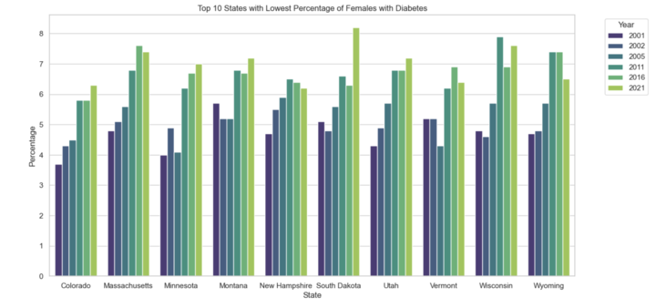
Top 10 States with Lowest Percentage of Males and Females with Diabetes
Colorado Massachusetts Minnesota Montana Utah Vermont Wisconsin Wyoming
Female Only
New Hampshire South Dakota
Male Only
Alaska Nebraska
State Correlations

Slide 8
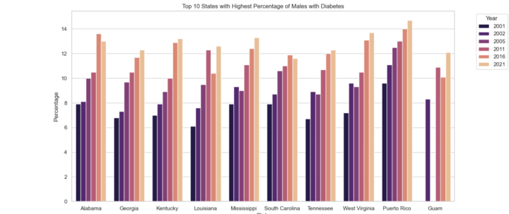
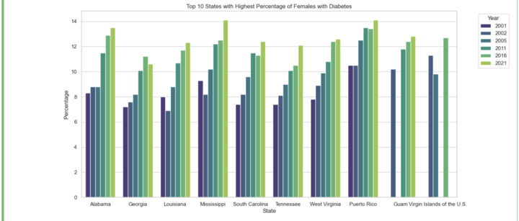
Top 10 States with Highest Percentage of Males and Females with Diabetes
Alabama
Georgia
Louisiana
Mississippi
South Carolina Tennessee
West Virginia
Puerto Rico
Guam
Female Only
Virgin Islands
Male Only
Kentucky
State Correlations

Slide 9
race
The dataset collected contained age group percentages. This information shows us how the distribution population diagnosed with diabetes over time that has changed.
18-44 age group had an increase over the years, approximately 1.80% in 2000 to 3.22% in 2021. This suggests younger population health has been impacted in a negative manner.
45-64 age group has remained stable with moderate fluctuations over time.
65-74 age group has had a gradual upward trend

Slide 10
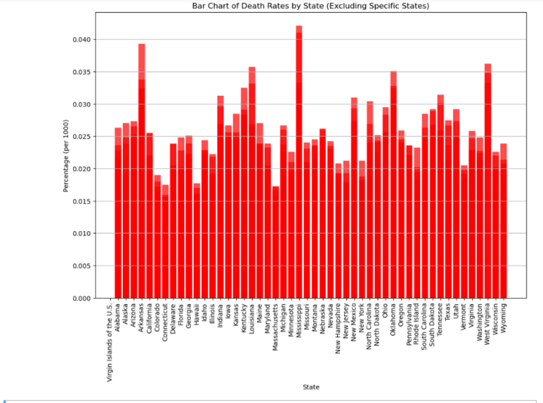
Death rates
The dataset collected contained age group percentages. This information shows us how the distribution population diagnosed with diabetes over time that has changed.

Slide 11
State statistics
The dataset collected contained age group percentages. This information shows us how the distribution population diagnosed with diabetes over time that has changed.
18-44 age group had a sizeable increase over the years, rising from approximately 1.80% in 2000 to 3.22% in 2021. This suggests younger population health has been impacted in a negative manner.
45-64 age group has remained stable with moderate fluctuations over time.
65-74 age group has had a gradual upward trend.

Slide 12
Additional Content
Subtitle
Subtitle
Subtitle
Add text, images, art, and videos.
Add transitions, animations, and motion.
Save to OneDrive, to get to your presentations from your computer, tablet, or phone.
Open the Design Ideas pane for instant slide makeovers.
When we have design ideas, we’ll show them to you right there.
This PowerPoint theme uses its own unique set of colors, fonts, and effects to create the overall look and feel of these slides.
PowerPoint has tons of themes to give your presentation just the right personality.

Slide 13

correlations
Walt Disney

Slide 14
Content
Subtitle
Subtitle
Add text, images, art, and videos.
Add transitions, animations, and motion.
Save to OneDrive, to get to your presentations from your computer, tablet, or phone.
Open the Design Ideas pane for instant slide makeovers.
When we have design ideas, we’ll show them to you right there.

Slide 15




Summary
With PowerPoint, you can create presentations and share your work with others, wherever they are. Type the text you want here to get started. You can also add images, art, and videos on this template. Save to OneDrive and access your presentations from your computer, tablet, or phone.

Slide 16

Thank you
Presenter name
Email address
Website

Slide 17
Timeline
Title
To start a presentation, go to the Slide Show tab, and select From Beginning.
Title
To display Presenter view, in Slide Show view, on the control bar at the bottom left select the three dots, and then Show Presenter View.
Title
During your presentation, the speaker notes are visible on your monitor, but aren't visible to the audience.
Title
The Notes pane is a box that appears below each slide. Tap it to add notes.
Title
If you don’t see the Notes pane or it is completely minimized, click Notes on the task bar across the bottom of the PowerPoint window.

Slide 18
Table
 | Category 1 | Category 2 | Category 3 | Category 4
Item 1 | 4.5 | 2.3 | 1.7 | 5.0
Item 2 | 3.2 | 5.1 | 4.4 | 3.0
Item 3 | 2.1 | 1.7 | 2.5 | 2.8
Item 4 | 4.5 | 2.2 | 1.7 | 7.0

Slide 19
Table
 | Category 1 | Category 2 | Category 3 | Category 4
Item 1 | 4.5 | 2.3 | 1.7 | 5.0
Item 2 | 3.2 | 5.1 | 4.4 | 3.0
Item 3 | 2.1 | 1.7 | 2.5 | 2.8
Item 4 | 4.5 | 2.2 | 1.7 | 7.0

